Slide 1

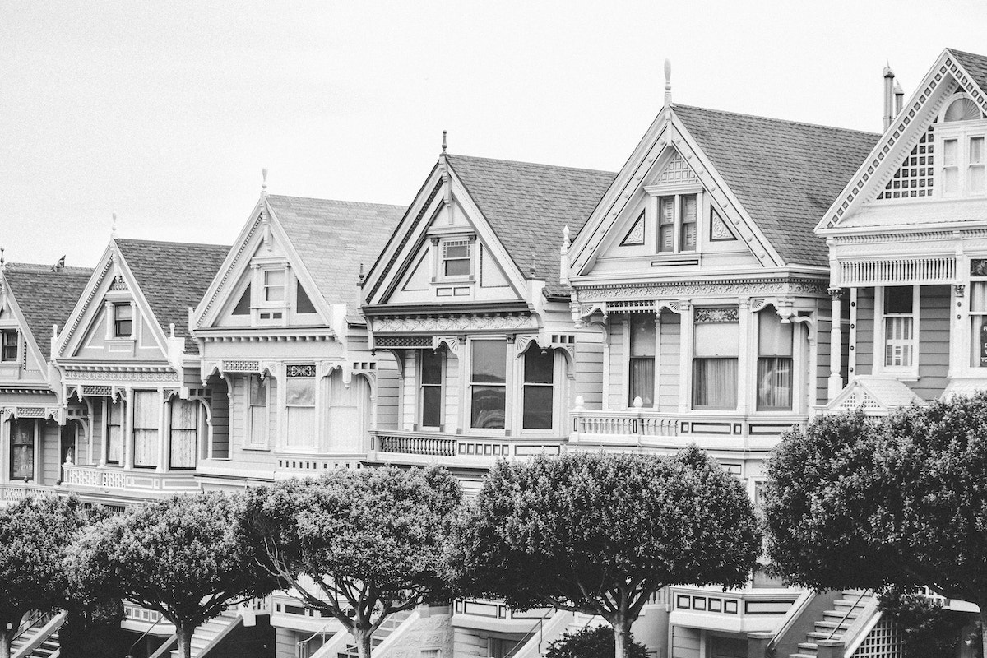
HOUSING 🏡 : PRICE PREDICTION
-Pooja Mishra

Slide 2
In this century, having house is one of the necessities for every person. House prices are increasing every year, so there is a need of system to predict the house prices. In this project, we are going to analyse the features and create the model to predict house prices. In this presentation, we’re going to create a model to predict House prices🏡 based on various factors across different markets.

Slide 3
About Dataset
🏡
This dataset has been taken from a US-based housing company named Surprise Housing. The main objective of this project is to analyse the train & test dataset to predict the house pricing. It comprises of test & train datasets which have 80 columns, 292 rows and 1168 rows with 81 features, respectively. Here the target feature is ‘SalePrice’ in train dataset.
This train dataset having null values which we will handle later. It consists of 3 float type, 35 integer type and 43 object type.
This test dataset having null values which we will handle later. It consists of 4 float type, 34 integer type and 42 object type..
In this DatasetThe Test data is what we will use to “teach” or train our model’.

Slide 4
data pre-processing
🏡
Dealing with Null Values: In this train Dataset, there are 18 columns consisting null values and in test dataset test dataset 19 columns have null values. All missing values in both datasets will be filled with mean and mode as per the category of values.
Dealing with Skewness – In these datasets, few of the columns do not follow the normal distribution that need to treat to convert it into normal distribution by applying NumPy log method.
In Data transformation we recheck that all present columns are numerical or not? Here we performed encoding to convert the features into numerical.
In this dataset, we have described the correlation and relationship present amongst each feature with target variable. Here we observed that there are many correlated variables in our dataset. We found few of the columns are positively corelated and few are negatively corelated.
We found values of numerical columns are not standard so for simplicity we use min-max scaler for all features.

Slide 5
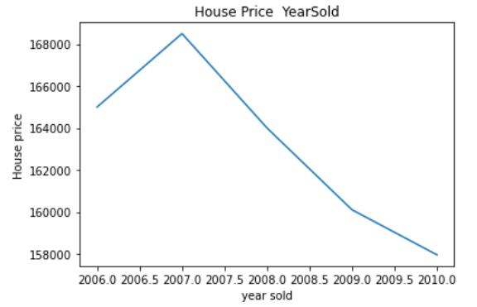
Data Visualization
Here we observed that with increase in year of house sold the price of house is decreasing. With this we are trying to get more information.
Temporal Datatime variable Analysis

Slide 6
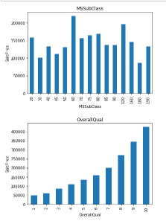
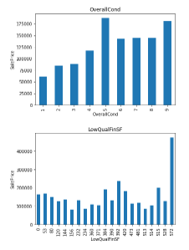
Analyzing visualization for discrete features
With above graphs we can say that there is relationship between discrete variables and sale price like Overall quality showing exponential relationship to saleprice. Monotonic relationship, uniform and non uniform relationship relationships with sale price. Thus, this visualization giving lots of information.

Slide 7
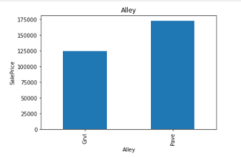
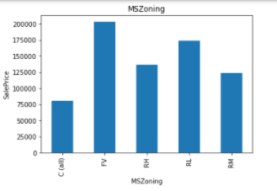
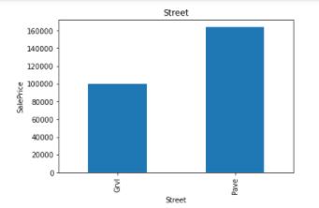
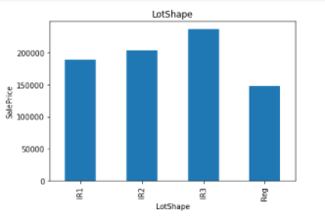
Analyzing relationship between categorical features and sale price
Categorical Features: The input and output features are uniformly and non-uniformly distributed.

Slide 8
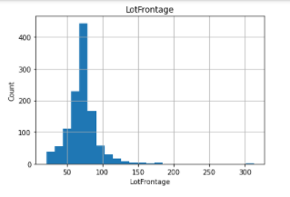
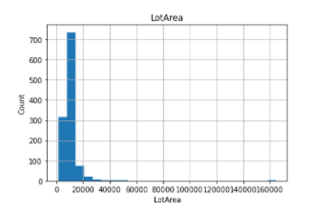
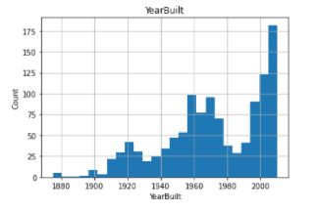
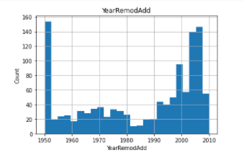
Analyzing house price relationship with continuous features
With all visualization on continuous features, we observed that few features have gaussian distribution which confirms that data is skewed. Thus, we will convert it into normal distribution feature engineering to get better modelling.

Slide 9
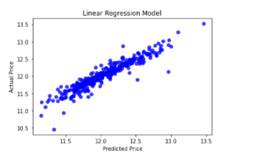
Model Development & Evaluation
1) Linear Regression
This technique models the relationship between the target variable and the independent variables (predictors).

Slide 10
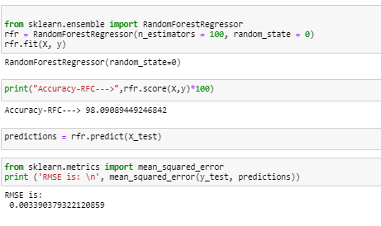
2) Random Forest Regressor
Bagging is an ensemble method where many base models are used with a randomized subset of data to reduce the variance of a the base model.

Slide 11
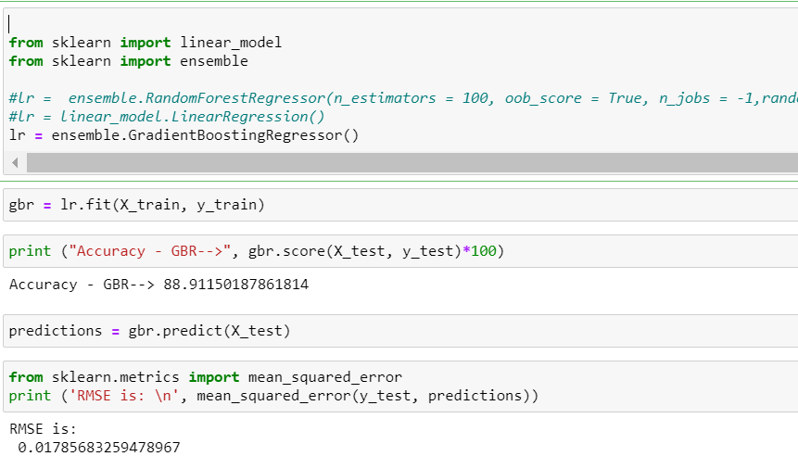
3) Gradient Boosting Regressor
Boosting is also an ensemble method where weak base models are used to create a strong model that reduces bias and variance of the base model.

Slide 12
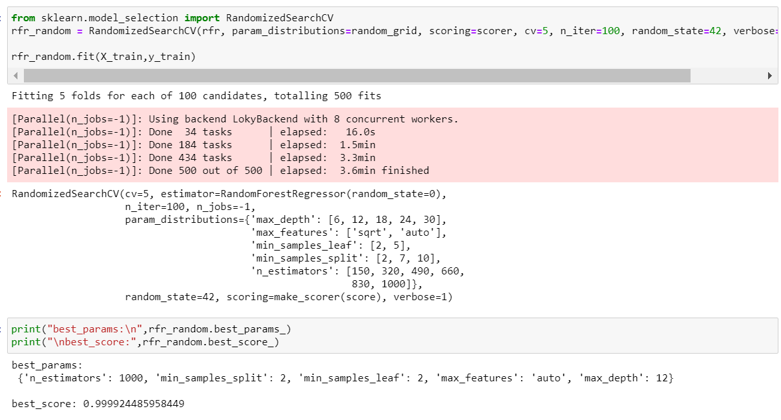
Hyper Parameter Tuning
We have performed Randomized Search to narrow down the possibilities to re-check the accuracy of this model so that we can conclude that Random Forest is the best fit model for this problem. This approach is more suited to get the best model selection confirmation.

Slide 13
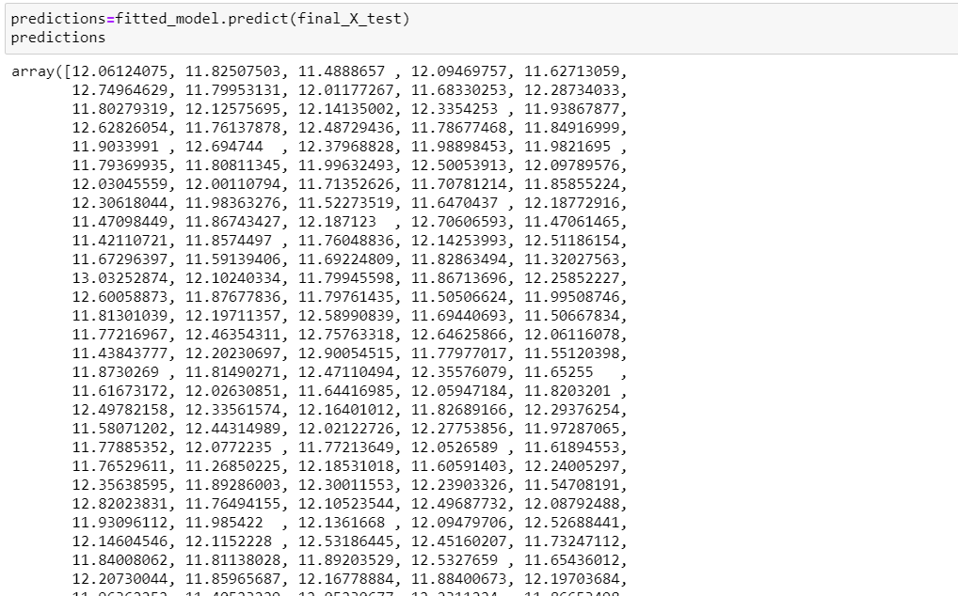
Prediction over test dataset
We created many models: for best model, we searched for good parameters then we constructed the model using those parameters, then trained (fitted) the model to our training data (X_train and y_train), as shown in figure.
then tested the model on our test data (X_test) and finally, we evaluated the model
performance by comparing the model predictions with the true values in y_test.

Slide 14
Conclusion
🏡
In this presentation, we built several regression models to predict the price of some house given some of the house features. We evaluated and compared each model to determine the one with highest performance. We also looked at how some models rank the features according to their importance. In this presentation, we followed the data science process starting with getting the data, then cleaning and preprocessing the data, followed by exploring the data and building models, then evaluating the results and communicating them with visualizations.
We also suggest people to take consideration of the features that were deemed as most important as seen in the feature selection section; this might help them estimate the house price better.

